Slide 1
Chapter 7: Authentication
Learning Bluemix & Cognitive
Bob Dill, IBM Distinguished Engineer, CTO Global Technical Sales

Slide 2
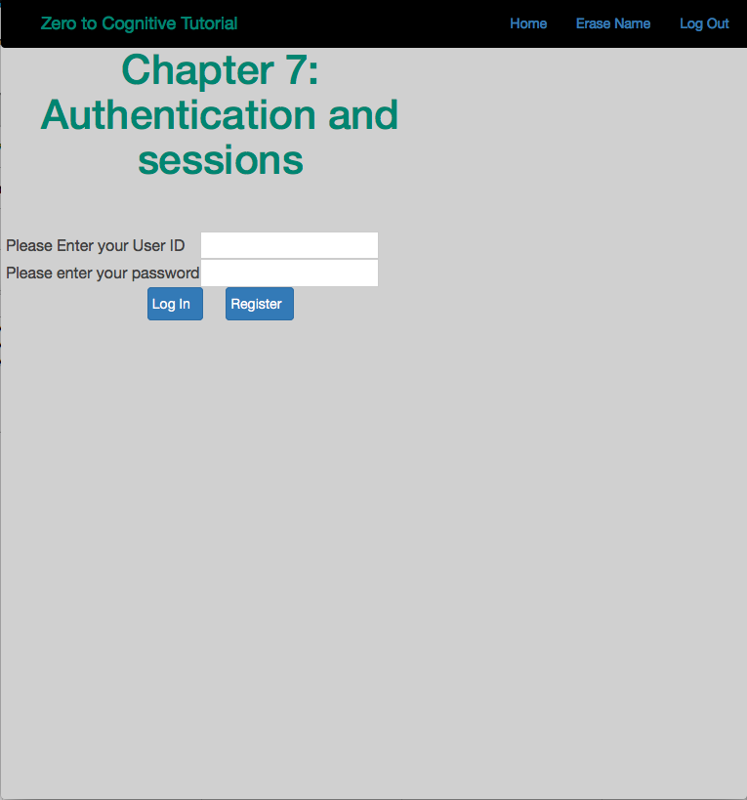
Chapter 7: Creating a secure application
SSL
Sessions
Cloudant
Storing session information
Storing userIDs
Responding to the user:
no userid
no password
not registered
userid password don’t match
success!!
Enabling your app to dynamically detect local or bluemix environments

Slide 3
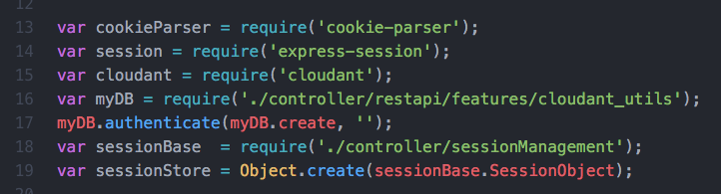
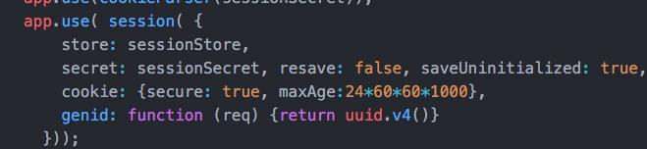

New in index.js
Modules
Environment
Session persistence
Tests
Paths

Slide 4
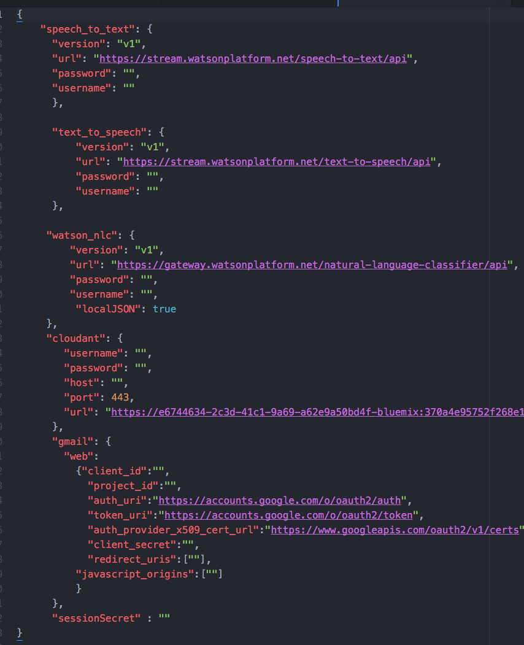
New files
index.html updated
body.html - new
login_1.html - new
z2c-login.js - new
authenticate.js - new
sessionManagement.js - new
cloudant_utils.js - new

Slide 5
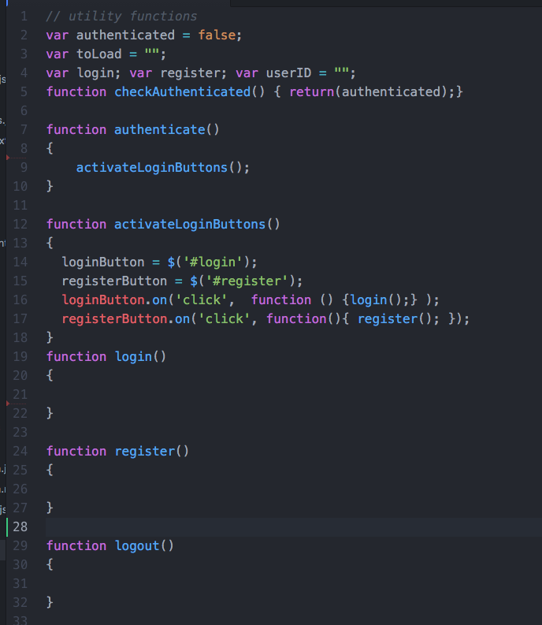
z2c-login.js

Slide 6
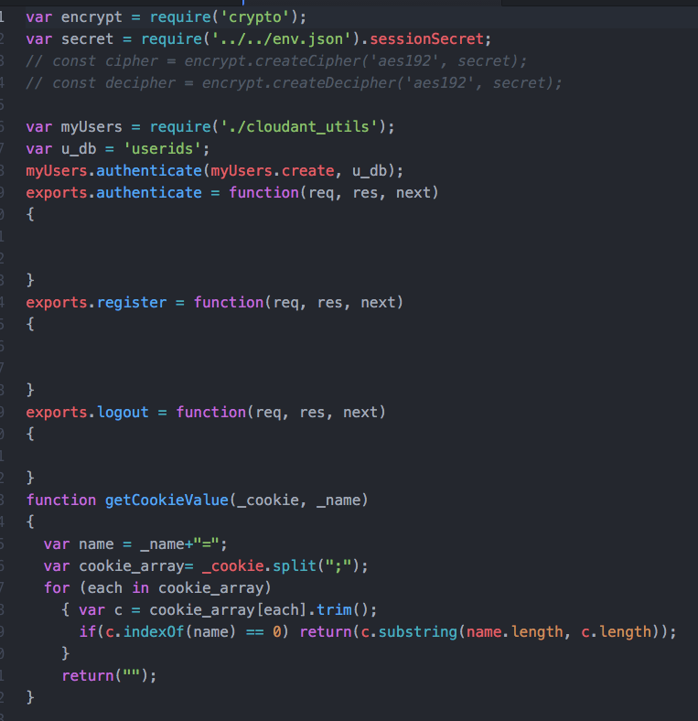
authenticate.js

Slide 7
You will need to create certificate files.
This information is also in the index.js file for Chapter 7:
for information on how to enable https support in osx, go here:
https://gist.github.com/nrollr/4daba07c67adcb30693e
Execute the following commands to create the necessary certificate files. You should be in the Chapter07 folder when you execute these commands. If you are running Linux, you will need to preface each command with sudo and then provide your login password when prompted.
openssl genrsa -out key.pem
openssl req -new -key key.pem -out csr.pem
openssl x509 -req -days 9999 -in csr.pem -signkey key.pem -out cert.pem

Slide 8
The Plan: 30 minute Chapters with an hour or two of practice
The Story, Architecture for this app
Setting up Bluemix
Building your first Watson App (Watson Speech to Text)
Getting Watson to talk back (Watson Text to Speech)
Understanding Classifiers (Watson NLC)
Creating a custom dialog with Watson (custom Q&A, session management)
Authentication (puts C2 thru 6 together)
Alchemy News (Watson Alchemy)
Visual Recognition and Images (Watson Visual Recognition)
Watson Conversations (Watson Conversations)
Rank & Retrieve (Watson Alchemy + Rank & Retrieve)
Getting started on my first client prototype Design Thinking, Stories, Architecture, Keeping it simple
Supporting Complex environments Public Bluemix and Docker
Supporting Complex environments II Bluemix Dedicated and CloudFoundry
Creating an Inference Engine Our Inference Engine in "R"
Finding solutions Integrates C1-10, 13-15)
BlueMix, Watson and Mobile (TBD)
September-October
4Q

Slide 9
Chapter 8: Understanding Alchemy News
Learning Bluemix & Cognitive
Bob Dill, IBM Distinguished Engineer, CTO Global Technical Sales

